Slide 1
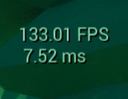
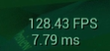
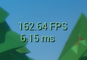
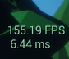
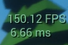
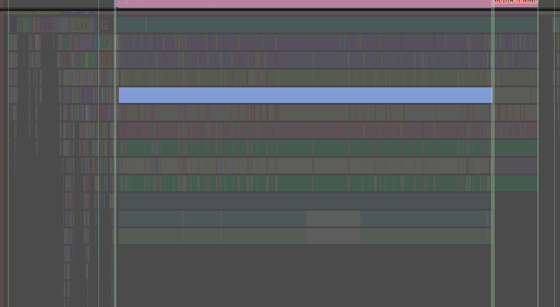
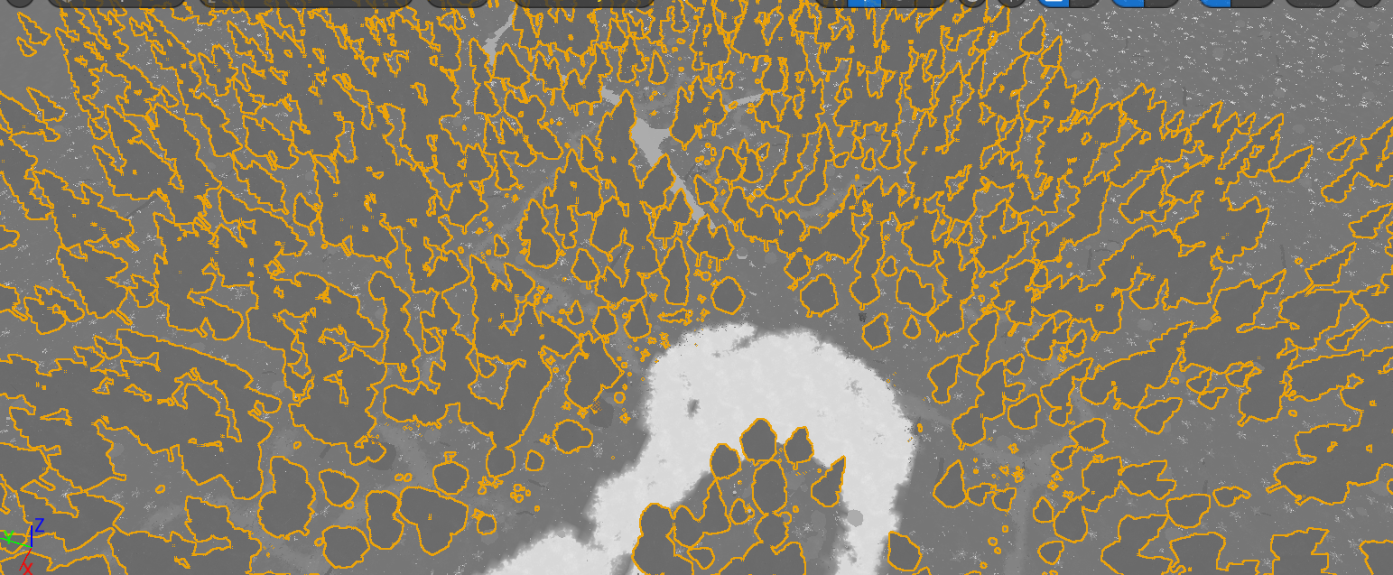
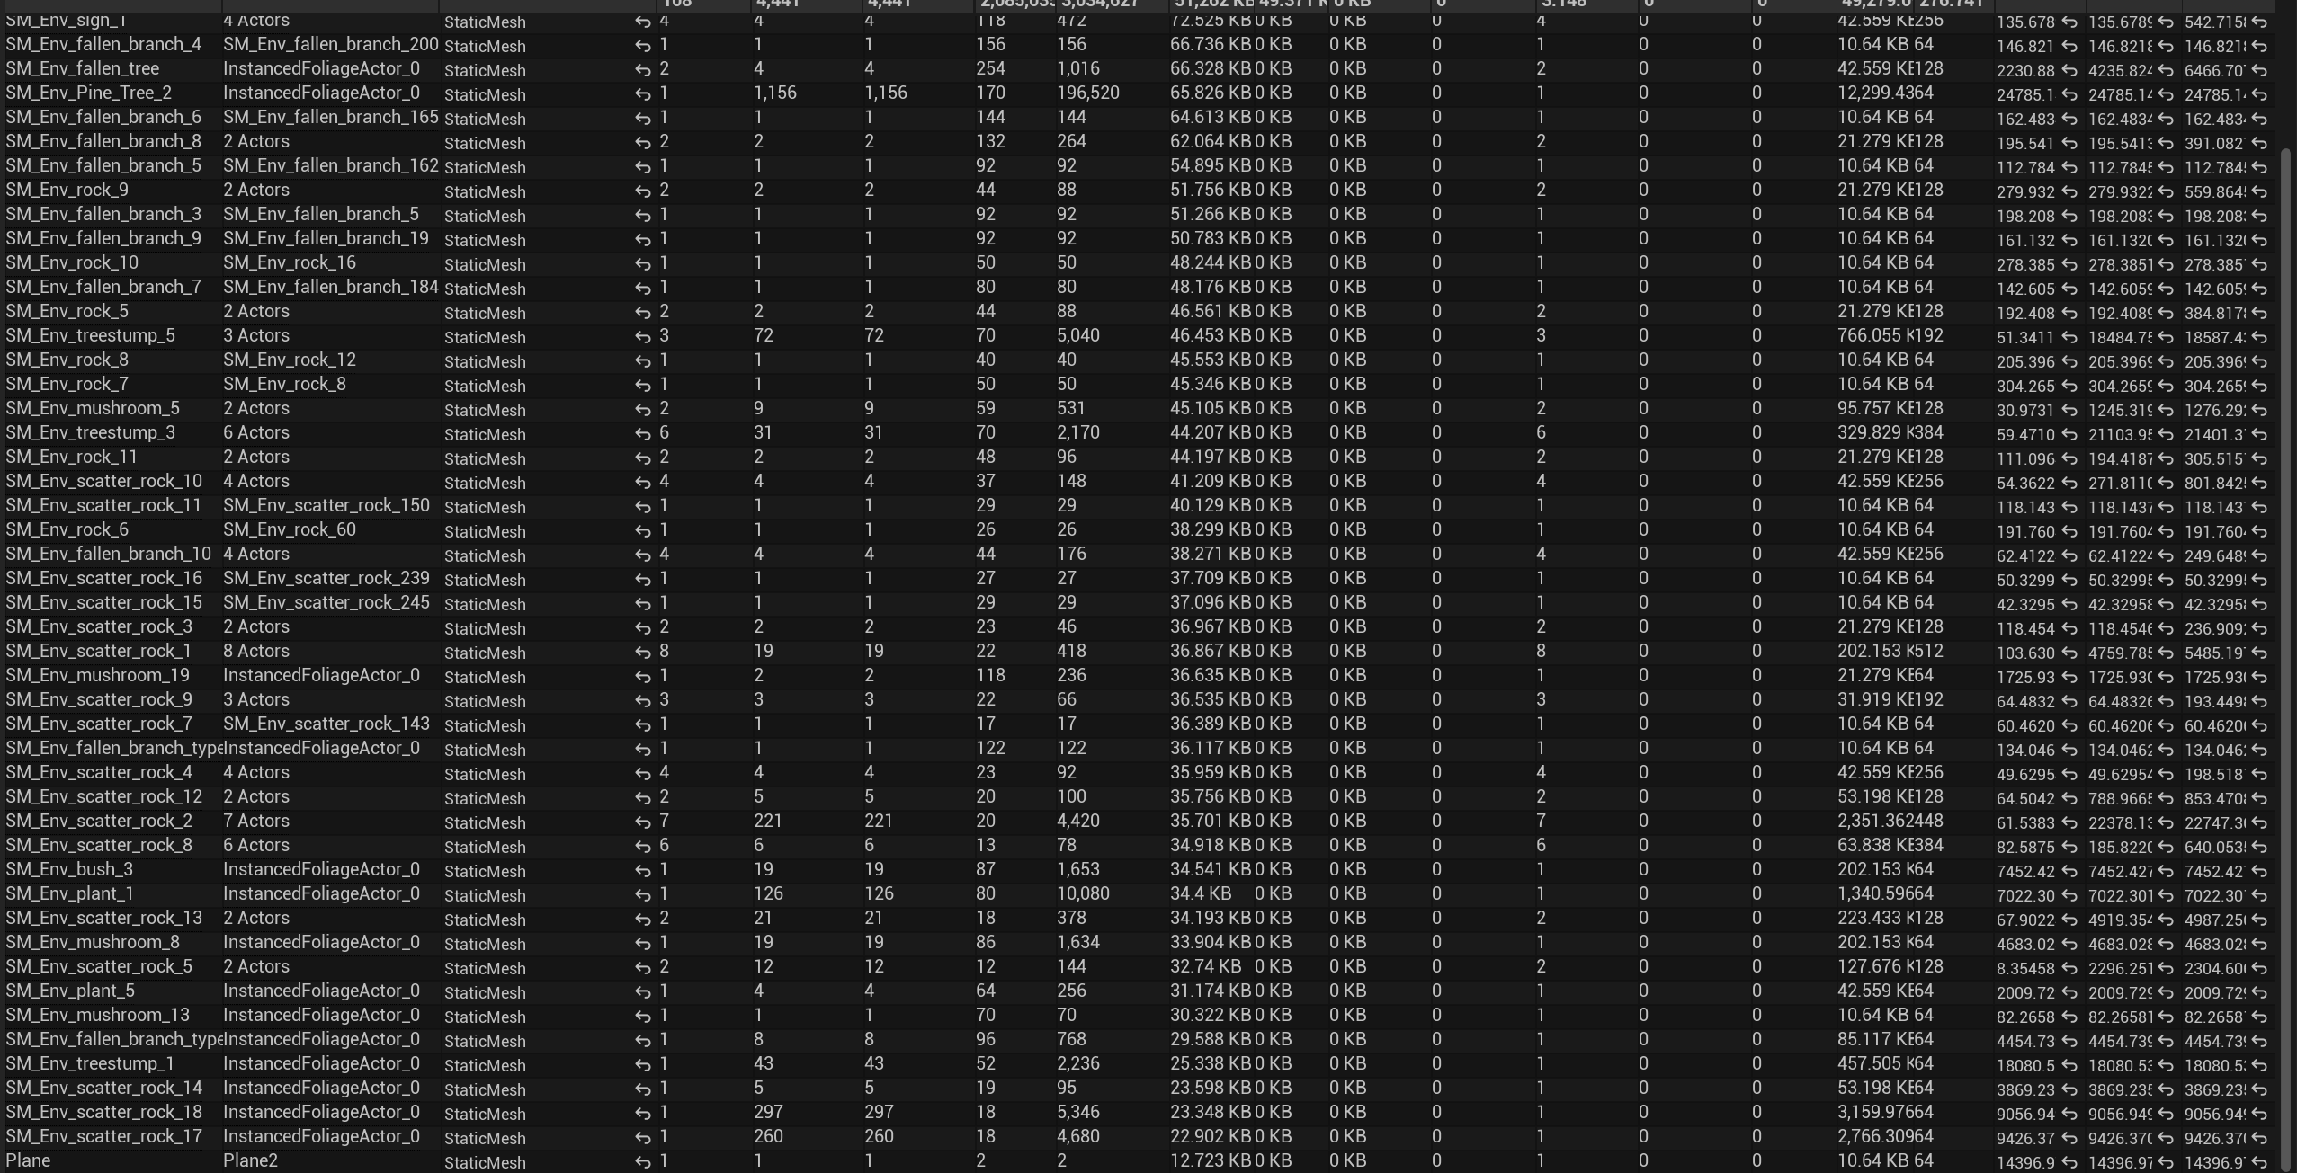
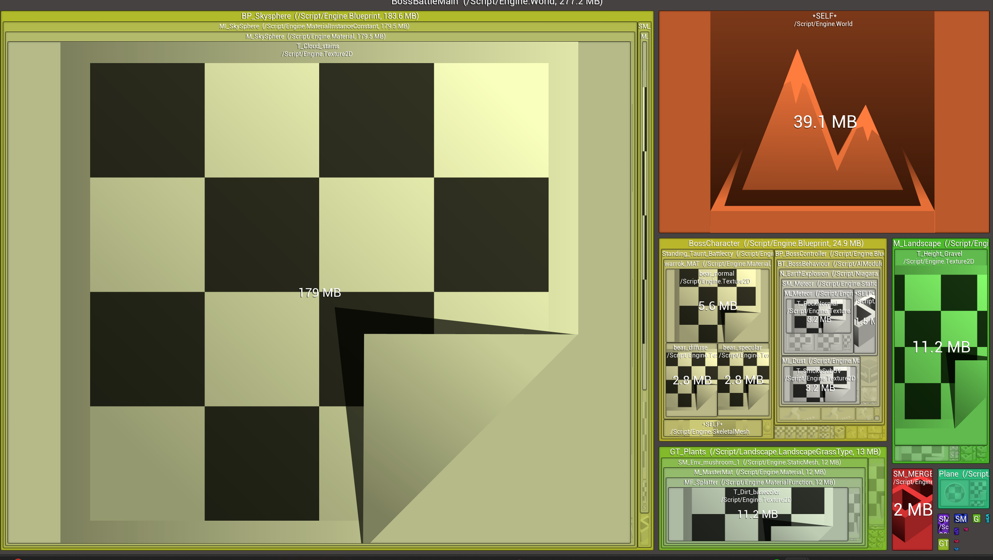
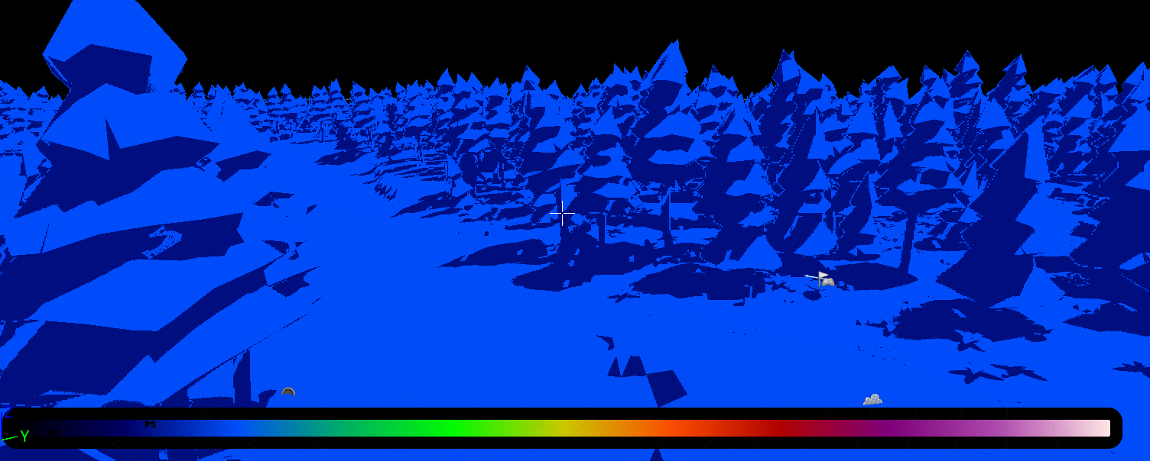
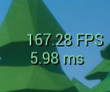
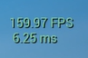
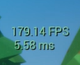
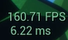
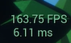
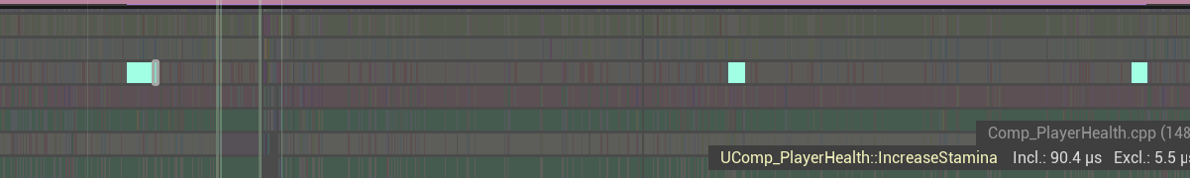
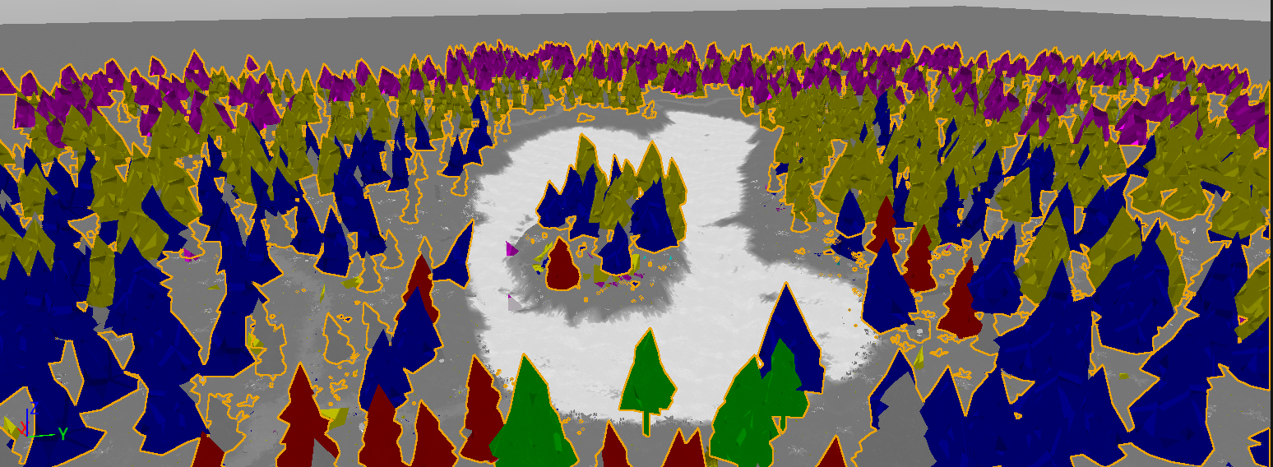
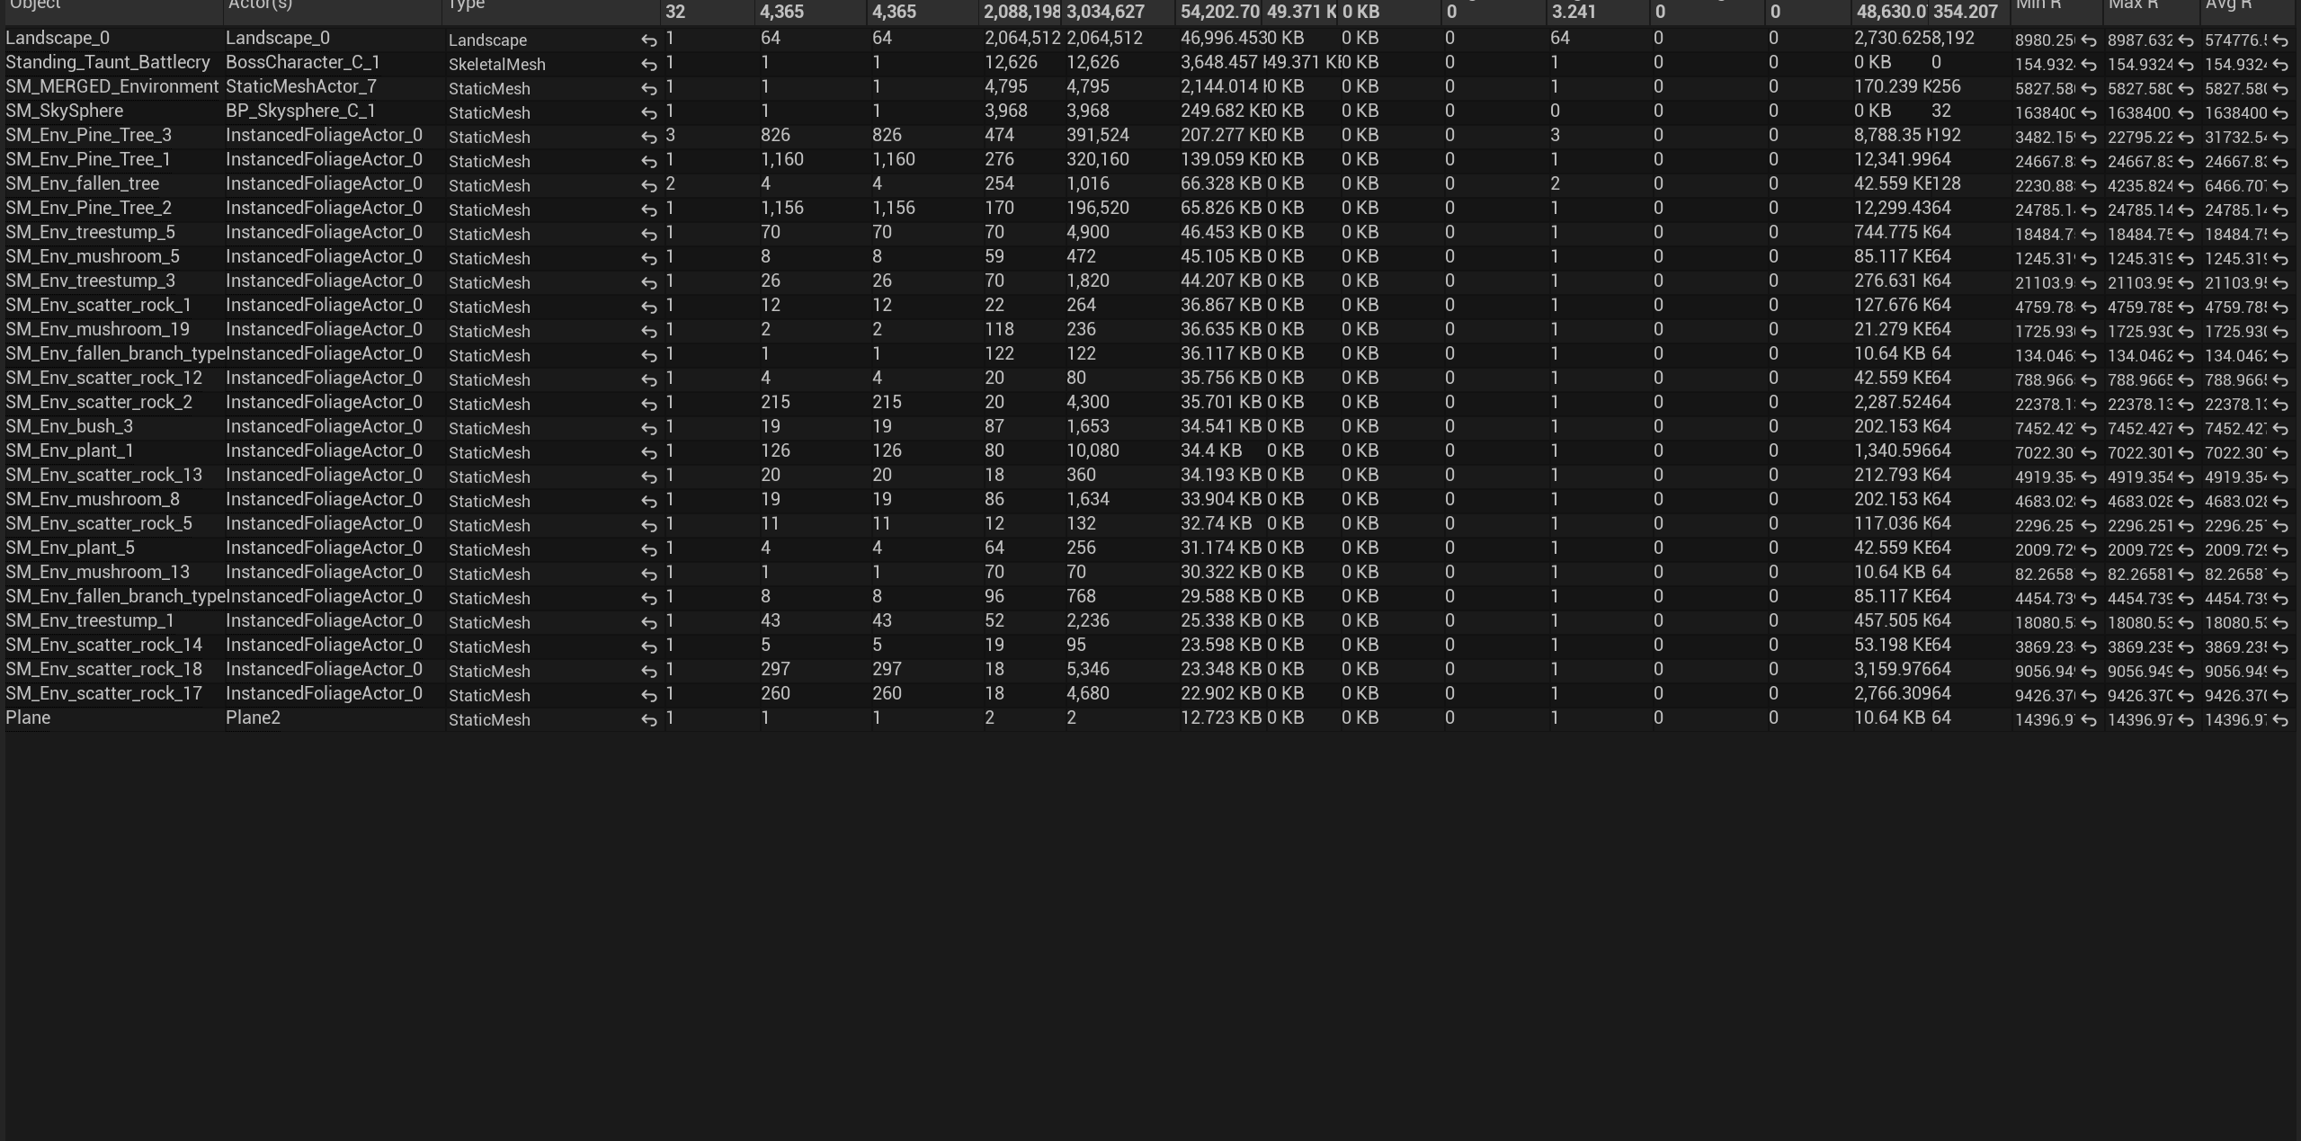
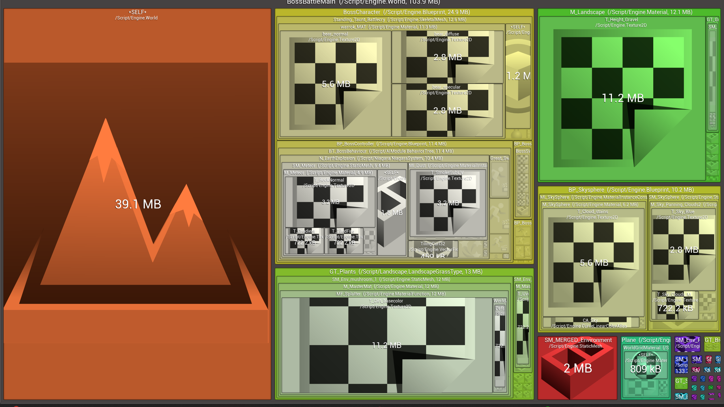
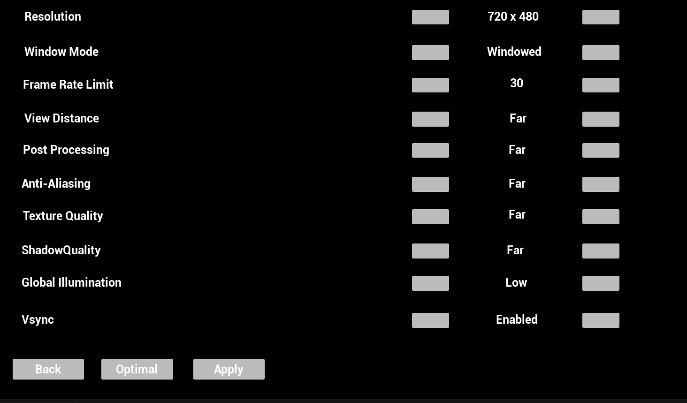
Boss Battle by Samuel Lloyd : 2300873
Frame Rates are massively different due to editor fluctuations. Improvements aren’t actually that much
Tick Profiler Problem:
Mesh LOD Problem:
Merging Problem:
Size Map Problem:
Light Problem:
Taking a looks at my level using the mesh LOD colourisation tool, I noticed there weren't any LOD's in my level. This means that no matter the distance from a mesh, it would always be rendered in the highest detail. This results in my scene taking a lot more time to render than it should do.
To fix this, I went into my meshes, and added multiple different layers of LOD, and set the distance requirements for each of them. This means that the further away the player is from a mesh, the less vertices it will be rendered with, but at the same time not really effecting the experience as the player wouldn't be able to make out the details from that far away either.
Opening the Main levels size map, and changing the view mode from disk to memory, what immediately stood out was the cloud texture at 179mb of memory, much larger than anything else. This is taking up much more memory than it should.
To fix this, I went into the texture, and changed its compression method, which was on the highest setting, to default. This changed its memory usage to 7mb, saving us 172mb of memory! This also hardly effected the player experience, as the change in the clouds was hardly noticeable, as they are a far away object.
To regenerate stamina, I constantly check if enough time has passed since last damaged in a tick function.
This creates a constant around 100 nanosecond drain on my CPU. I found this out by adding a trace to the tick function in the profiler.
To fix this, I rewrote the code to use timers instead, so it would only need to check when stamina was not full.
It now clears the previous timer, then sets a new one, to be triggered after the recovery delay, which when triggered, recursively calls itself until stamina is full.
This saves us from a tick functions, improving the overall frame rate of the project.
Using the Light complexity view, I noticed my lights could be optimised further as it was all light blue, where I could make it dark blue. Unfortunately, changing it to static didn't make much of a difference, and changing other options had too much of an effect on the gameplay experience.
So, as a solution, I created an options menu where the player could adjust the lighting settings themselves, so users who don't have a great PC can change the lighting settings to be lower, reducing the complexity, and effecting the gameplay experience as a cost. However, players with higher end PC's, who wouldn't have to worry about the added complexity, could play on the higher settings, keeping the original gameplay experience intact.
Opening the statistics window, the first thing that stood out to me was that I had a lot of similar objects, such as foliage and tress, and individual objects.
After some research, I found out I could speed up rendering times by merging them, as this would reduce draw calls, but not effect the game, as these are all static objects.
Unoptimised:
Unoptimised:
Unoptimised:
Unoptimised:
Unoptimised:
Optimised:
Optimised:
Optimised:
Optimised:
Optimised:

